Slide 1
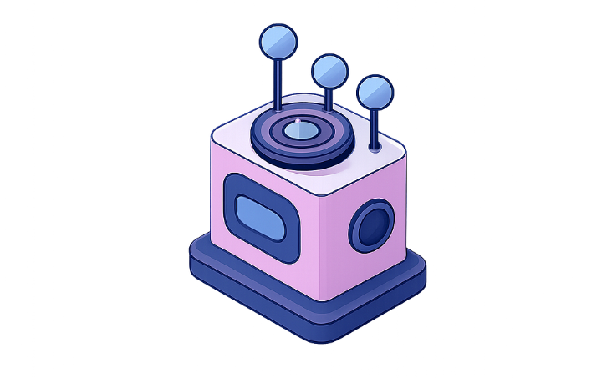
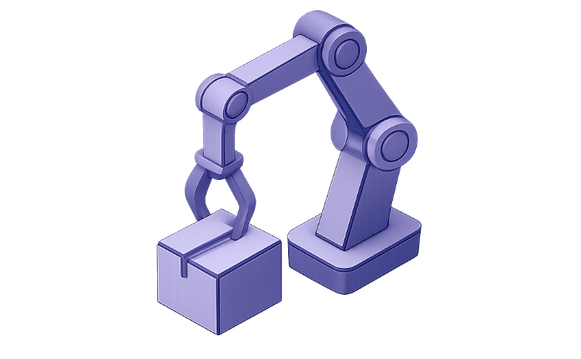

Advanced Policy Optimization Techniques in Deep Reinforcement Learning
PPO, TRPO & DDPG
Course: Reinforcement Learning for Environment and Agent (MLA03) · Assessment Tool 1
Name: M. Nandhini Registration No: 192472318
Agent → Environment Loop
Visual motif
Agent observes state → selects action → environment returns next state & reward → policy updated
Subtle robotics and AI visuals to emphasise control and perception

Slide 2
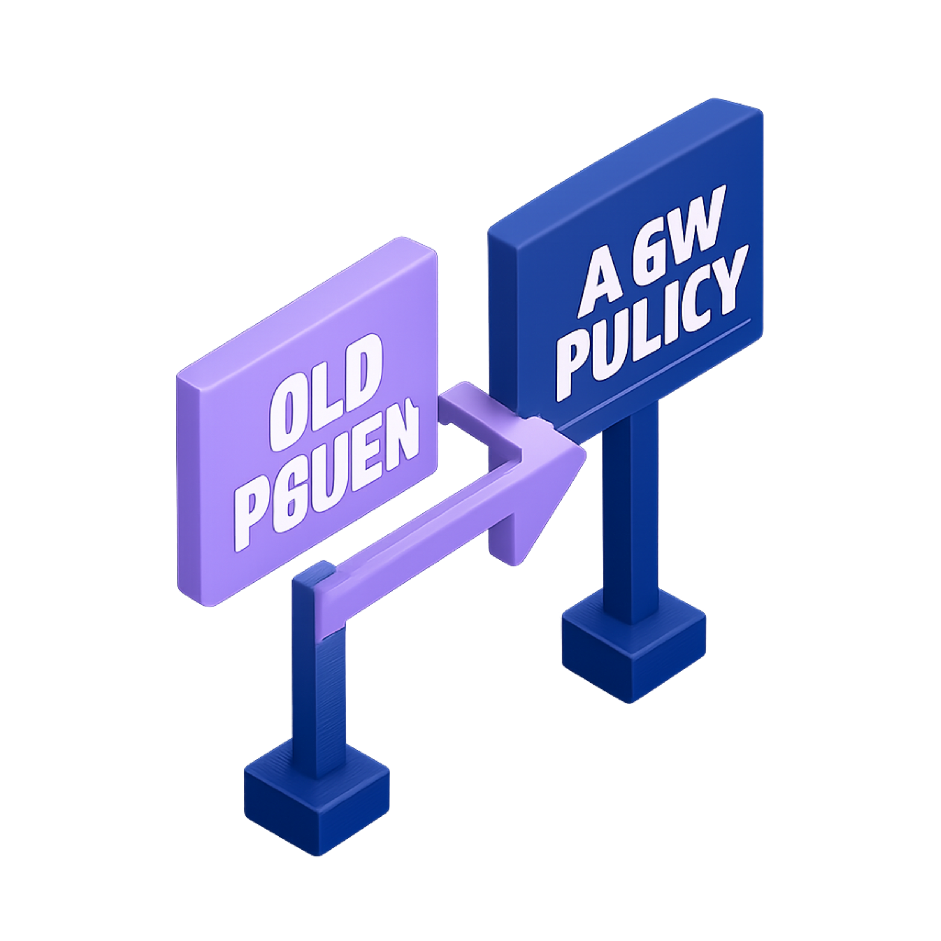
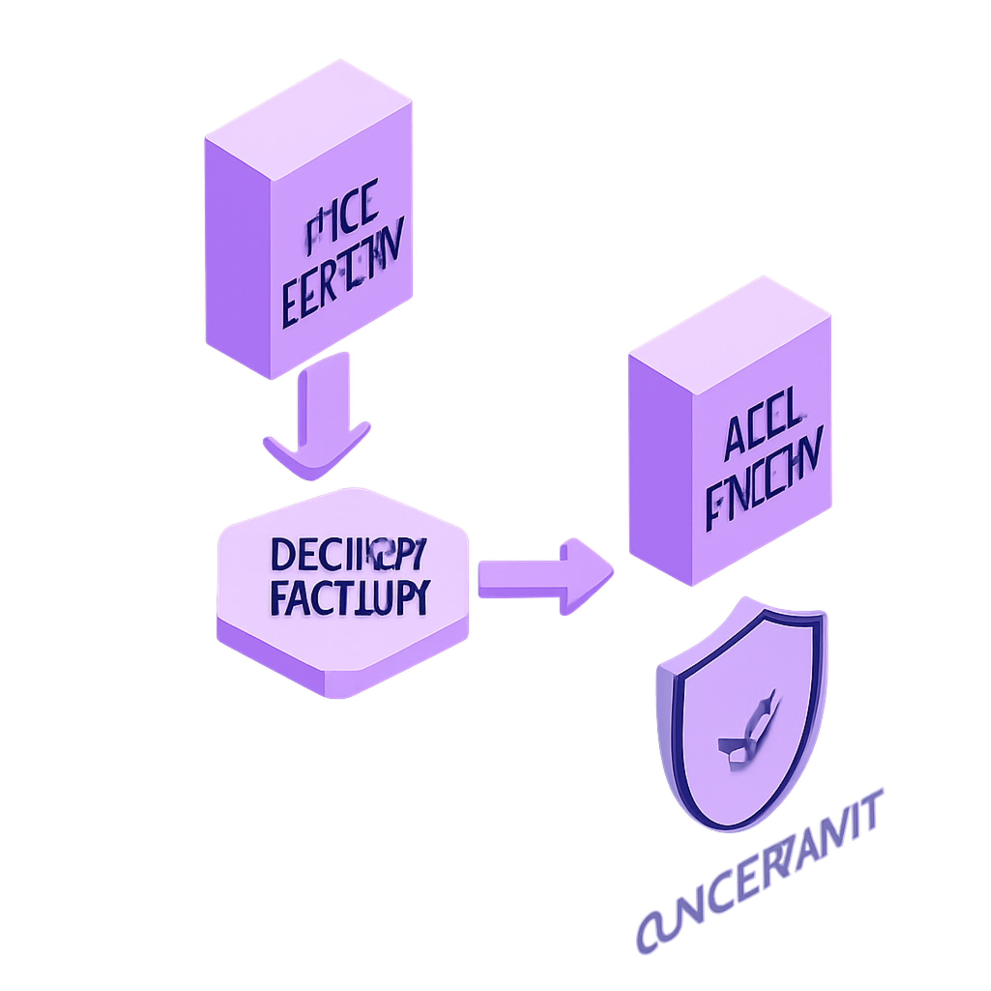
Policy Optimization in Reinforcement Learning
Reinforcement learning trains an agent to maximise expected cumulative reward by improving a policy π(a|s).
Policy optimization directly updates π to increase long‑run returns. Advanced methods trade sample efficiency, stability and computational cost.
Proximal Policy Optimization (PPO)
Trust Region Policy Optimization (TRPO)
On‑policy policy gradient method with surrogate objective
Uses a clipping mechanism to limit policy ratio r(θ) = π_θ(a|s)/π_{θ_old}(a|s)
Balances update size vs. performance — prevents large harmful updates
Relatively simple, robust and widely used in practise
Constrained optimization: maximise surrogate objective subject to a KL divergence bound
Uses KL(π_{θ_old} || π_θ) to enforce a trust region (step size control)
Strong theoretical stability guarantees, but requires conjugate gradient / Hessian-vector ops
More computationally intensive than PPO
Visual: Left — PPO: Old Policy → Controlled Update → New Policy. Right — TRPO: Old Policy → Trust Region Constraint → Safe New Policy.

Slide 3
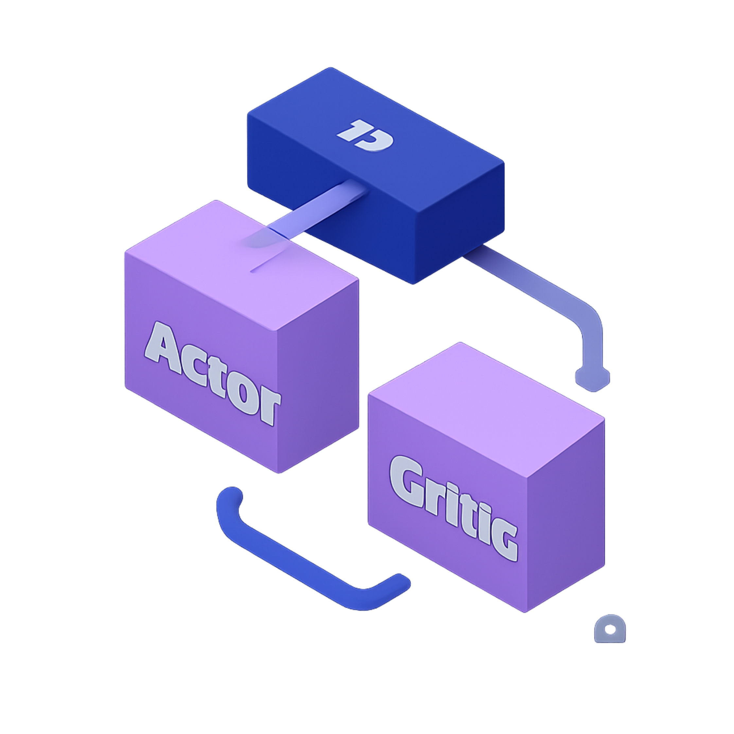
DDPG — Deep Deterministic Policy Gradient
Actor‑Critic algorithm for continuous action spaces. Learns deterministic policy μ_θ(s) (Actor) and Q_φ(s,a) (Critic).
Combines off‑policy learning with replay and target networks for stability.
Actor
Maps state → continuous action (e.g., steering, motor torque). Updated using policy gradient from Critic.
Critic
Estimates Q(s,a). Provides gradients to update Actor; trained with Bellman targets using experience replay.
Stability components
Target Actor/Critic networks, experience replay buffer, and exploration noise (e.g., OU/process or Gaussian)
Architecture flow: State → Actor → Action → Environment → Reward, Next State → Replay Buffer → Critic → Updates → Actor/Critic target networks.

Slide 4
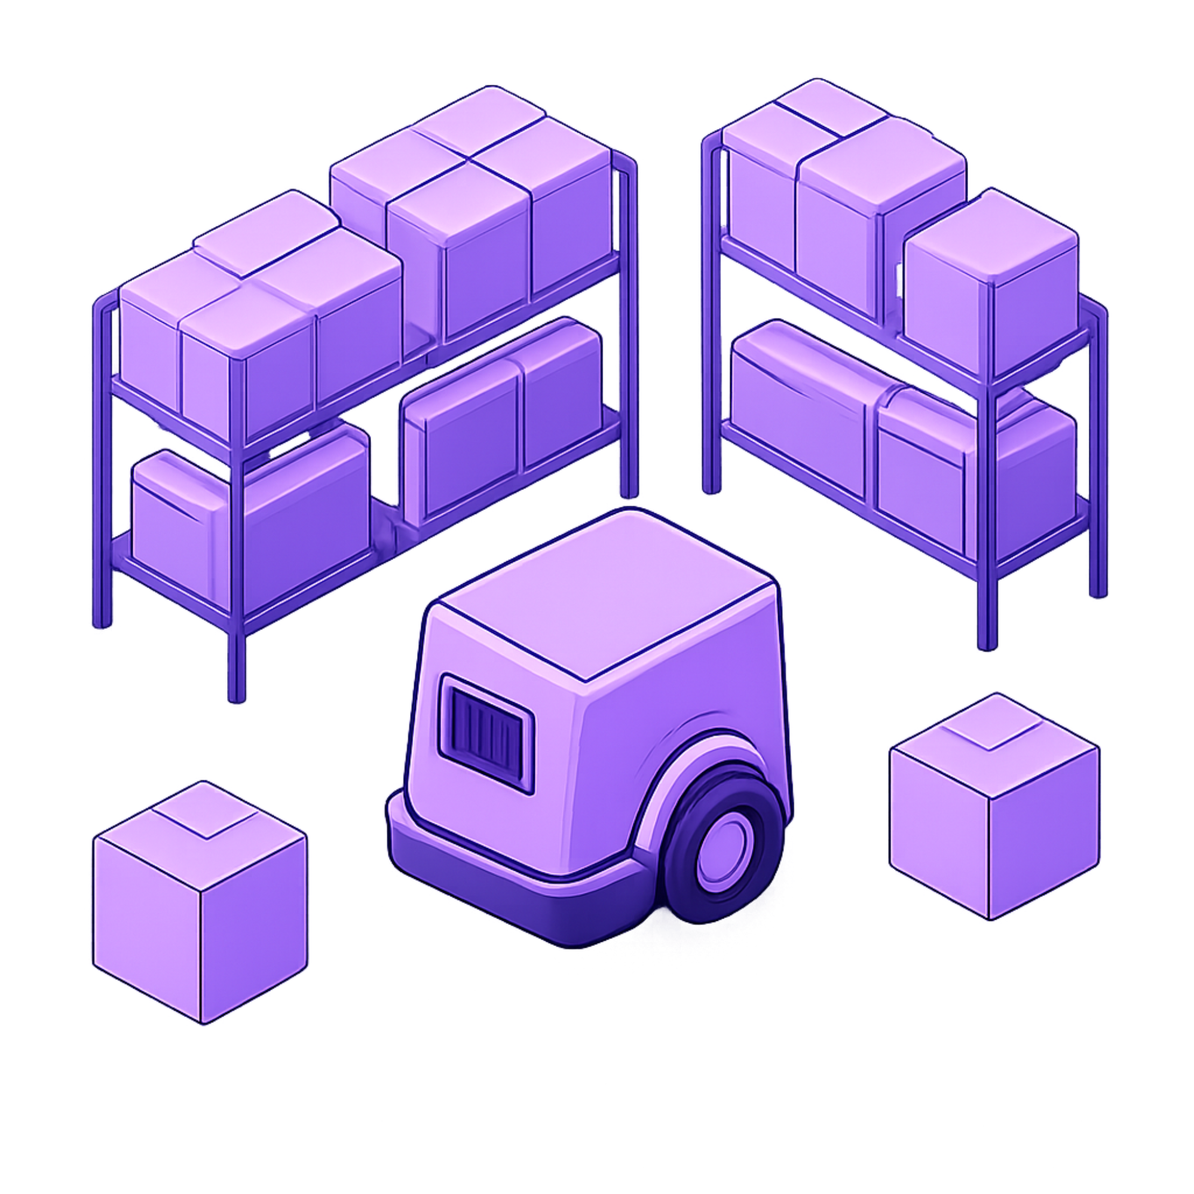
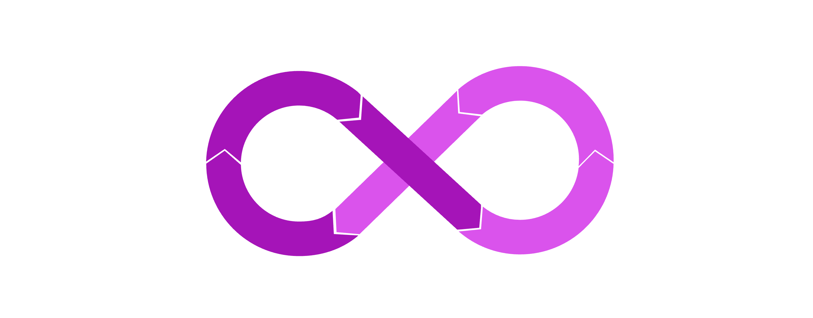
Practical Example — Warehouse Robot
Scenario & Elements
Task: locate, pick and deliver packages safely and efficiently
State: position, package locations, obstacle map, velocity, destination
Actions: move forward/turn, change speed, arm control (continuous)
Rewards: pickup (+), delivery (high +), collisions (−), drop (−), efficiency (+)
Algorithm roles (applied)
PPO — stepwise policy improvements; safe incremental updates during online tuning
TRPO — enforce conservative updates when safety is critical (low collision risk)
DDPG — produce precise continuous controls for steering, speed and arm actuators
Observe Environment
Select Action
Store Experience
Execute Action
Use the diagram during explanation to walk through a single episode and show where each algorithm's strengths apply: stability (PPO/TRPO) vs precise continuous control (DDPG).

Slide 5

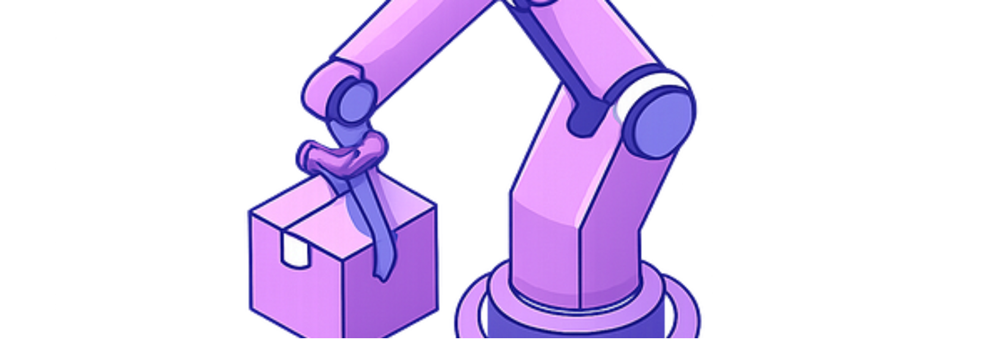
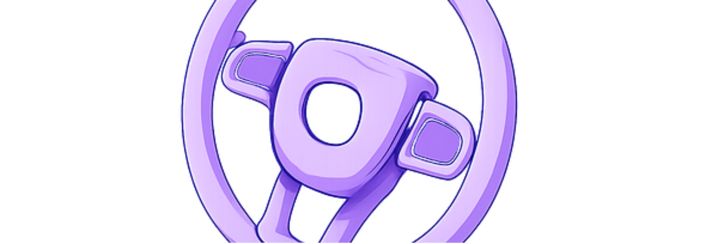
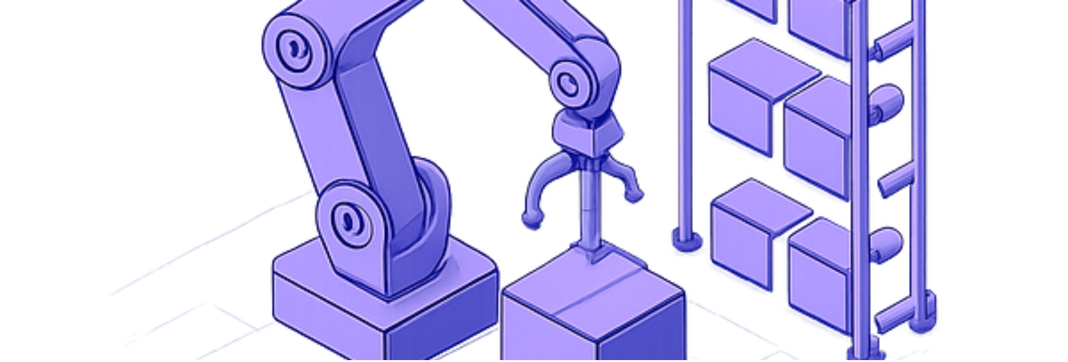
Comparison, Applications & Conclusion
Feature | PPO / TRPO / DDPG | Summary | Notes
Main approach | PPO: Policy OptimizationTRPO: Policy OptimizationDDPG: Actor‑Critic | Policy gradient vs constrained policy update vs deterministic actor–critic | Choose by action space & stability needs
Policy update | PPO: ClippingTRPO: Trust region (KL)DDPG: Gradient from Critic | Controls update magnitude (PPO/TRPO); DDPG relies on critic accuracy | TRPO heavy compute; PPO practical; DDPG needs careful tuning
Action space & stability | PPO: Discrete/Continuous, High stabilityTRPO: Discrete/Continuous, Very high stabilityDDPG: Mainly Continuous, Moderate stability | DDPG excels at fine continuous control; PPO/TRPO for robust policy improvement | Replay, targets and exploration critical for DDPG
Applications
Conclusions
Robotics & manipulation
Autonomous vehicles & drones
Smart manufacturing & industrial automation
Continuous control systems (process control, motion planning)
PPO — simple, practical clipped updates for stable improvement.
TRPO — strong trust‑region control for high stability; higher compute.
DDPG — deterministic actor‑critic for precise continuous actions; requires replay, targets and careful exploration.
The choice depends on action space, stability requirements, computational budget and
application constraints.

